Slide 1
Hypothesis Testing
Chad Williams
University of Victoria

Slide 2
Lecture Outline
Steps for Hypothesis Testing
Define Hypotheses
Select Sampling Distribution
Set a priori criteria
Compute statistics
Make statistical decision
Interpret your outcome

Slide 3
Lecture Outline
Steps for Hypothesis Testing
Define Hypotheses
Select Sampling Distribution
Set a priori criteria
Compute statistics
Make statistical decision
Interpret your outcome

Slide 4
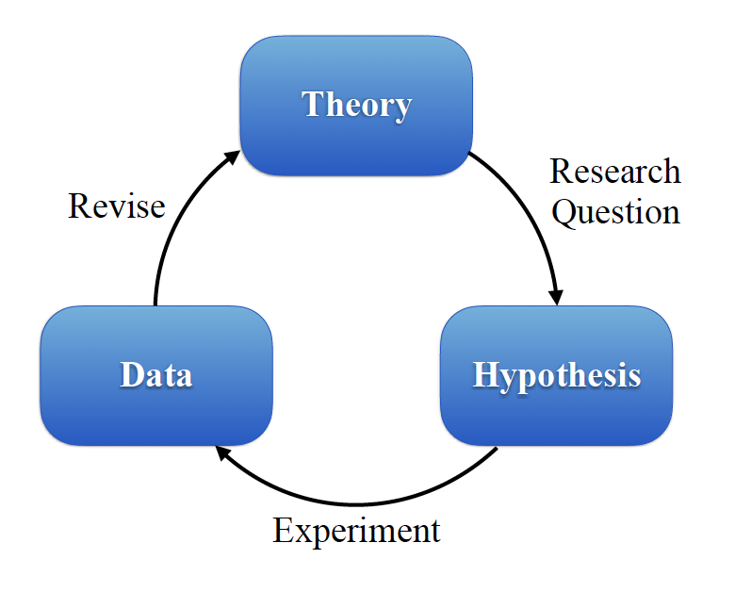
Science!
Have a theory
Develop a research question to test the theory
State specific hypothesis based on research question
Run the experiment
Collect and analyze data
Revise theory based on observed data
Repeat

Slide 5
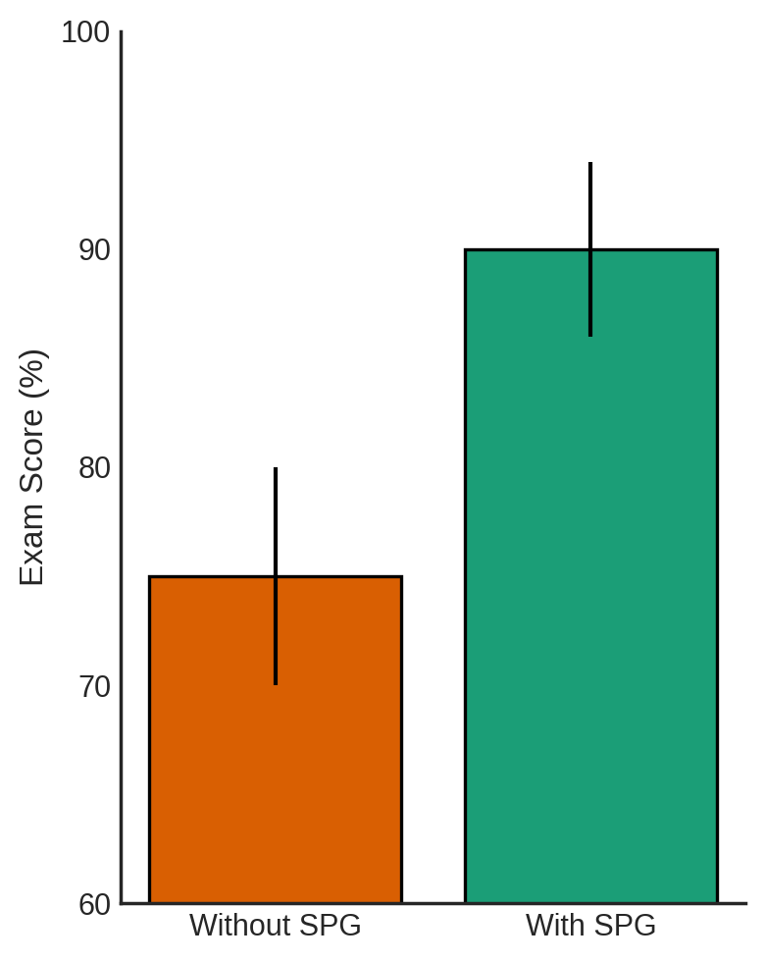
Steps of Hypothesis Testing
Hypothesis Testing: Protocol to follow for research
Goal of hypothesis testing is to rule out chance (sampling error) as a plausible explanation for the results from a research study
Steps of Hypothesis Testing
Define Hypotheses
Select Sampling Distribution
Set a priori criteria
Compute statistics
Make statistical decision
Interpret your outcome

Slide 6
Steps of Hypothesis Testing
Jo is taking statistics and came across a Statistics Problem Generator (SPG) to practice their computations. We want to know whether this generator gave Jo an advantage or disadvantage in comparison to past classes that did not have the SPG.
Independent Variable
Past classes without SPG (population)
Jo with SPG (sample)
Dependent Variable
Exam score

Slide 7
Steps of Hypothesis Testing
For example:
Past Classes Without SPG
Population Parameters: μ = 75.00, σ = 6.50
Jo With SPG
Sample Statistics: x = 90.00
Assume p(α) = .05 and a two-tailed test
We will cover what this means in these slides

Slide 8
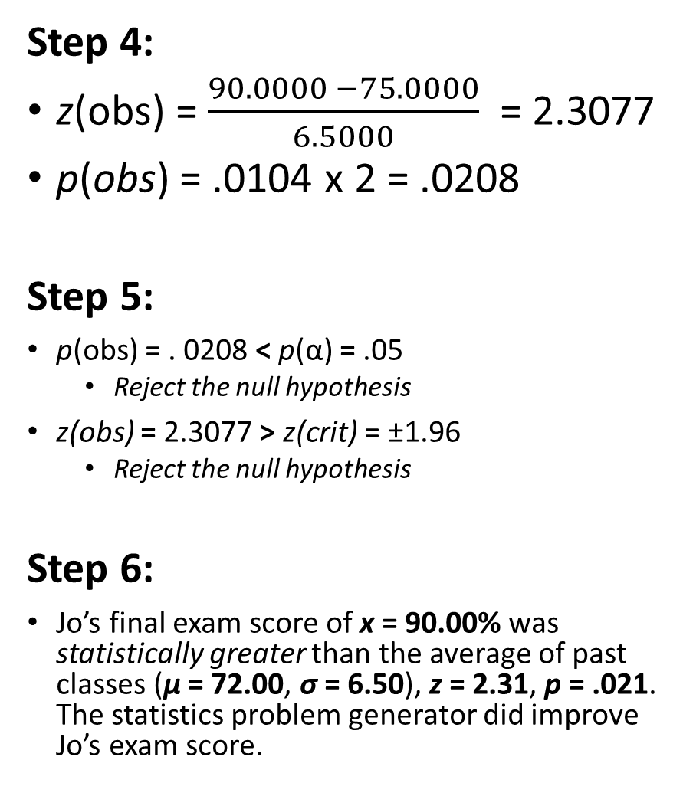
Step 1:
H₀: μ = 75.00
H₁: μ ≠ 75.00
Thus, two-tailed
Step 2:
Type of Research Design: Single-Participant Design
Model of Hypothesis Testing: Random Sampling
Nature of Data (Scales of measurement): Score data
Statistic Being Analyzed: X
Information about the Population: μ = 75.00, σ = 6.50, N = 500
Sample Size: n = 1
Shape: Normally distributed
Step 3:
p(α) = .05, z(crit) = ±1.96
Step 4:
z(obs) = $\frac{90.0000 −75.0000}{6.5000}$ = 2.3077
p(obs) = .0104 x 2 = .0208
Step 5:
p(obs) = . 0208 < p(α) = .05
Reject the null hypothesis
z(obs) = 2.3077 > z(crit) = ±1.96
Reject the null hypothesis
Step 6:
Jo’s final exam score of x = 90.00% was statistically greater than the average of past classes (μ = 72.00, σ = 6.50), z = 2.31, p = .021. The statistics problem generator did improve Jo’s exam score.

Slide 9
Lecture Outline
Steps for Hypothesis Testing
Define Hypotheses
Select Sampling Distribution
Set a priori criteria
Compute statistics
Make statistical decision
Interpret your outcome

Slide 10
Step 1: Define Hypotheses
Theory: Conceptual description of a phenomenon
Derived from past research or observations of the world
Tested with specific research question
Determine two specific hypotheses
Null & Alternative

Slide 11
Step 1: Define Hypotheses
Alternative Hypothesis (H₁): Derived from theory, reflecting the concept being studied
Considered the opposite of H₀
E.g., Difference of exam scores between Jo with SPG and past classes without SPG
Difference ≠ 0
Null Hypothesis (H₀): Suggests no relationship between DV and IV
NHST: Goal is to disconfirm the null hypothesis
E.g., No difference of exam scores between Jo with SPG and past classes without SPG
Difference = 0

Slide 12
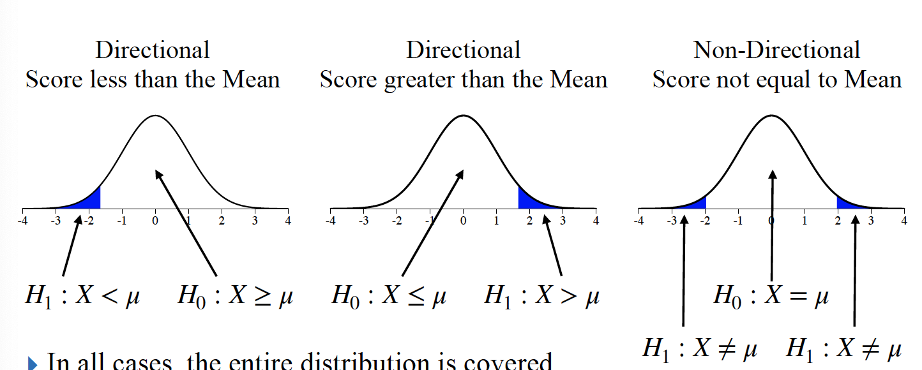
Step 1: Define Hypotheses
Example: μ = 75.00, σ = 6.50, x = 90.00
Non-Directional (in words) – Two tailed
H₀: There is no difference in exam scores between Jo that used the SPG and past classes that did not use the SPG
H₁: There is a difference in exam scores between Jo that used the SPG and past classes that did not use the SPG

Slide 13
Step 1: Define Hypotheses
Example: μ = 75.00, σ = 6.50, x = 90.00
Directional (in words) – One tailed
H₀: Jo using the SPG will result in lower or equal exam scores than past classes that did not use the SPG
H₁: Jo using the SPG will result in higher exam scores than past classes that did not use the SPG

Slide 14
Step 1: Define Hypotheses
Example: μ = 75.00, σ = 6.50, x = 90.00
Non-Directional – Two tailed
H₀: μ = 75.00
H₁: μ ≠ 75.00
Directional – One tailed
H₀: μ ≤ 75.00 H₀: μ ≥ 75.00
H₁: μ > 75.00 H₁: μ < 75.00

Slide 15
Step 1:
H₀: μ = 75.00
H₁: μ ≠ 75.00
Thus, two-tailed

Slide 16
Lecture Outline
Steps for Hypothesis Testing
Define Hypotheses
Select Sampling Distribution
Set a priori criteria
Compute statistics
Make statistical decision
Interpret your outcome

Slide 17
Step 2: Select the Sampling Distribution
We do not always know population parameters (mean, variability), but we can try and estimate them
We can do this by building a sampling distribution of the mean
It is an estimate of the population parameters based on the current sample
Signifies all possible outcomes if the null hypothesis is true
We will cover this in more detail later in the course (Unit 4.1.)
For now, we will just describe its characteristics

Slide 18
Step 2: Select the Sampling Distribution
Characteristics of Hypothesis Testing
Type of Research Design
E.g., Single-Participant Design
Model of Hypothesis Testing
E.g., Random Sampling
Nature of Data (Scales of measurement)
E.g., Score data (interval or ratio)
Statistic Being Analyzed
E.g., X
Information about the Population
E.g., μ and σ are known
Sample Size
E.g., n = 1
Shape
Normally distributed

Slide 19
Step 2: Select the Sampling Distribution
Type of Research Design | Single Participant Design
Model of Hypothesis Testing | Random Sampling
Nature of Data | Score data
Statistic Being Analyzed | X
Information of Population | μ = 75.00, σ = 6.50, N = 500
Sample Size | n = 1
Shape | Normally Distributed

Slide 20
Step 1:
H₀: μ = 75.00
H₁: μ ≠ 75.00
Thus, two-tailed
Step 2:
Type of Research Design: Single-Participant Design
Model of Hypothesis Testing: Random Sampling
Nature of Data (Scales of measurement): Score data
Statistic Being Analyzed: X
Information about the Population: μ = 75.00, σ = 6.50, N = 500
Sample Size: n = 1
Shape: Normally distributed

Slide 21
Lecture Outline
Steps for Hypothesis Testing
Define Hypotheses
Select Sampling Distribution
Set a priori criteria
Compute statistics
Make statistical decision
Interpret your outcome

Slide 22
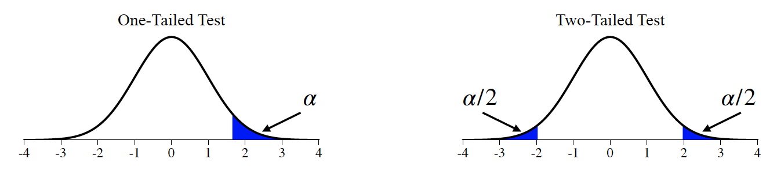
Step 3: Determine a priori Criteria
a priori criterion
Defined proportion under the null hypothesis distribution that observed data is by chance
Set by the researcher before the study begins
Probability you are willing to find something by accident
Convention in most science is p = .05

Slide 23
Step 3: Determine a priori Criteria
Directionality
One-Tailed (Directional): Area at one tail of the distribution
Makes it easier to find a significant result if you are looking in the right direction
Need lots of empirical support
E.g., we hypothesize that the SPG will increase Jo’s exam scores

Slide 24
Step 3: Determine a priori Criteria
Directionality
Two-Tailed (Non-Directional): Area split between each tail of the distribution
Makes it harder to find significant result but allows you to look at each side of the distribution
The default
E.g., we hypothesize that the SPG will change Jo’s exam scores
May increase or decrease

Slide 25
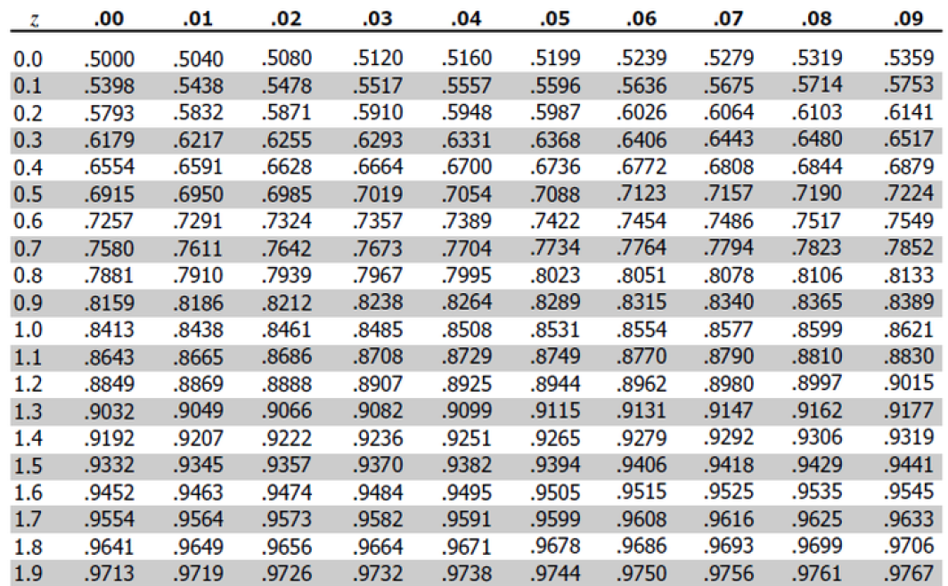
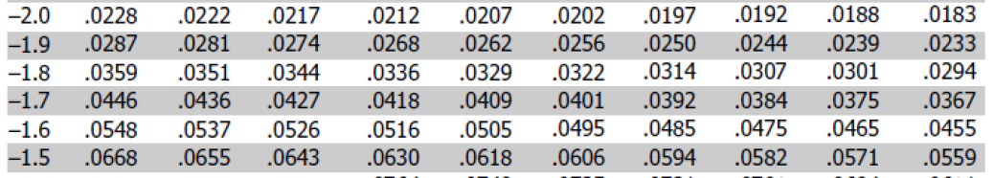
Step 3: Determine a priori Criteria
p(α): Probability (p-value) cut-off to determine whether something is the same or different
p(α) = .05

Slide 26
Step 3: Determine a priori Criteria
Z(crit): The z-score cut-off to determine whether something is the same or different
Two-Tailed z(crit): ±1.96

Slide 27
Step 3: Determine a priori Criteria
p(α): Probability (p-value) cut-off to determine whether something is the same or different
p(α) = .05

Slide 28
Step 3: Determine a priori Criteria
Z(crit): The z-score cut-off to determine whether something is the same or different
One-Tailed z(crit): +1.645 OR – 1.645

Slide 29
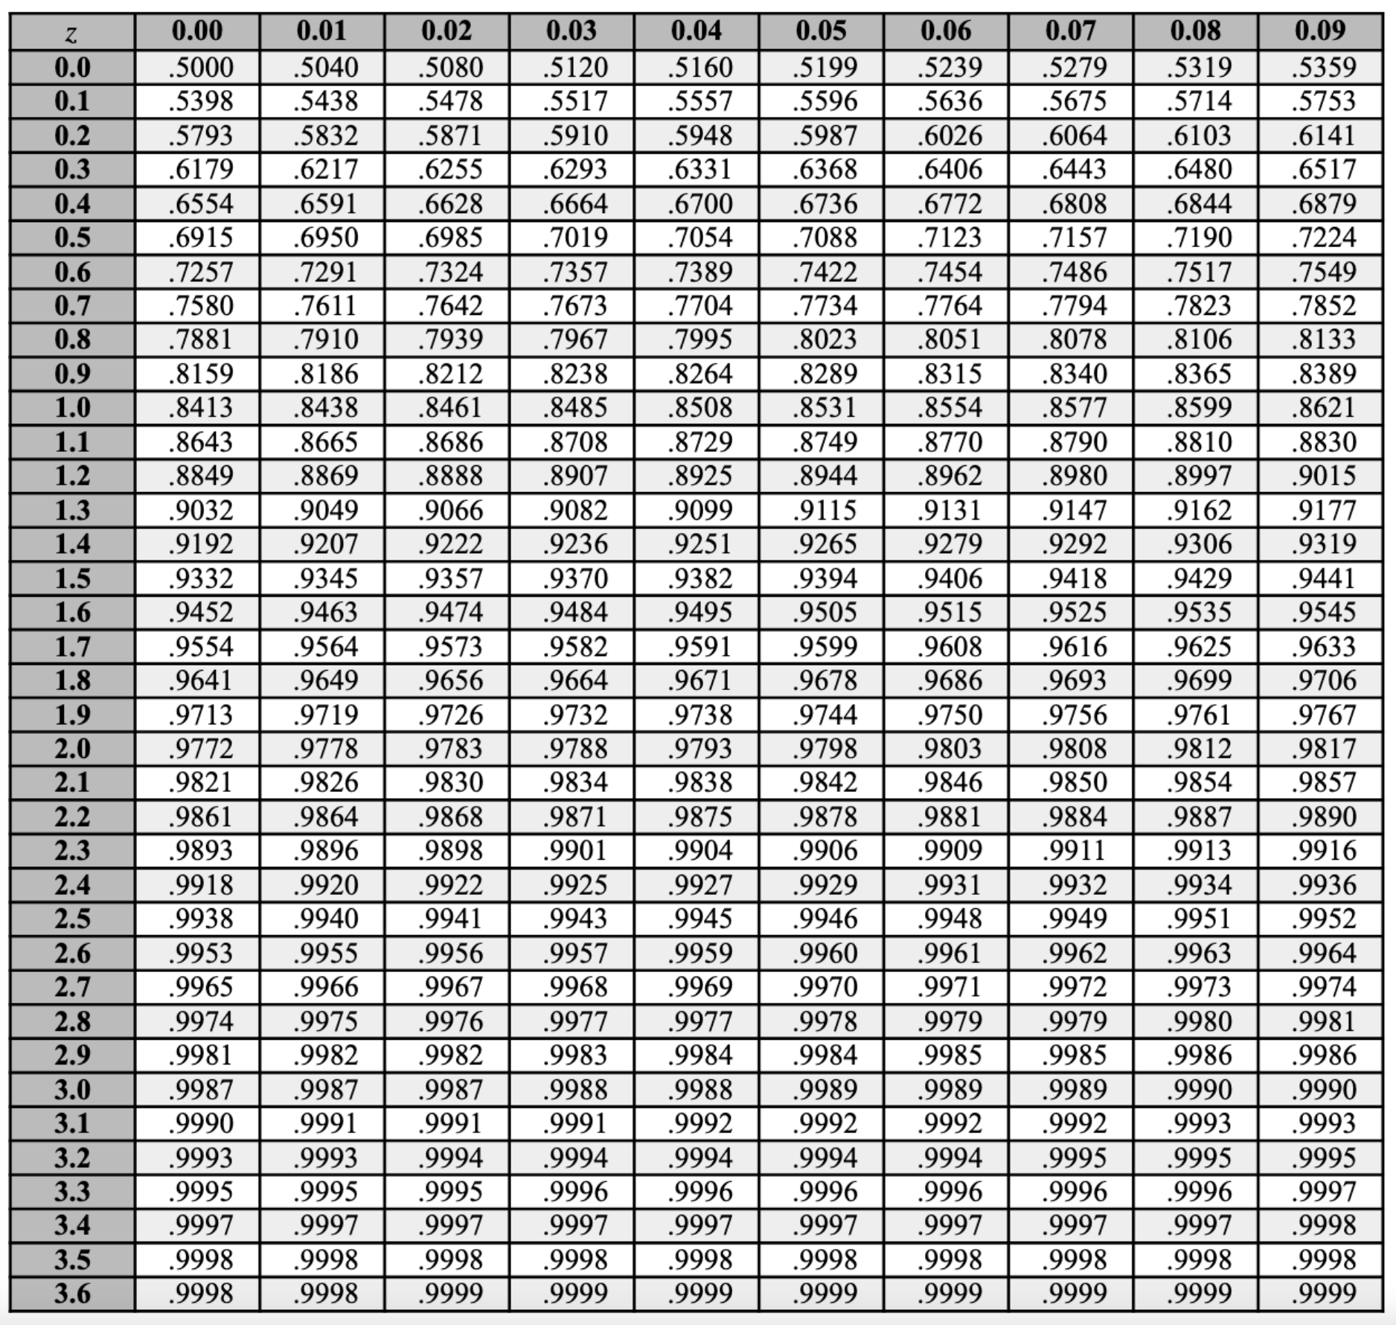
Step 3: Determine a priori Criteria
Z(crit): The z-score cut-off to determine whether something is the same or different
Two-Tailed z(crit): ±1.96
p(α) = .05/2 = .0250
1 - .0250 = .9750

Slide 30
Step 3: Determine a priori Criteria
Z(crit): The z-score cut-off to determine whether something is the same or different
One-Tailed z(crit): +1.645 OR – 1.645
p(α) = .05
1 - .0500 = .9500

Slide 31
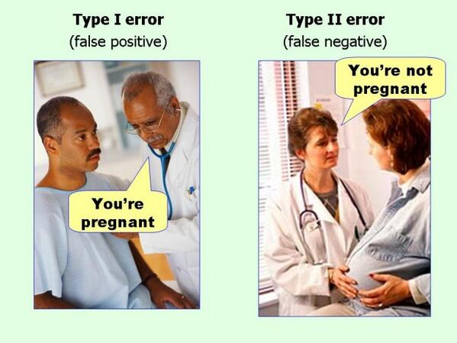
Step 3: Determine a priori Criteria
Types of Errors:
Type 1 Error: You reject the null when you should not have
Found something by accident
p(obs) < .05 but should have been > .05
What you found
What you should
have found

Slide 32
Step 3: Determine a priori Criteria
Types of Errors:
Type 2 Error: You retained the null when you should not have
You missed something by accident
p(obs) > .05 but should have been < .05
What you found
What you should
have found

Slide 33
Step 3: Determine a priori Criteria
Types of Errors:
Type 3 Error: You missed something because you were looking in the wrong direction
p(obs) > .05 but should have been < .05
Type 3 Error
Where you looked
Where you should
have looked
Where our data is

Slide 34
Step 3: Determine a priori Criteria
Actual state of the null hypothesis
(i.e., what is happening in the population in the real world)
 | No Effect Exists H₀ True H₁ False | Real Effect Exists H₀ False H₁ True
Reject H₀ | Type I Error | Correct Rejection
Fail To Reject H₀ | Correct Failure to Reject | Type II Error
What our study finds

Slide 35
Step 3: Determine a priori Criteria
Actual state of the null hypothesis
(i.e., what is happening in the population in the real world)
 | No Effect Exists H₀ True H₁ False | Real Effect Exists H₀ False H₁ True
Reject H₀ | Type I Error | Correct Rejection
Fail To Reject H₀ | Correct Failure to Reject | Type II Error
What our study finds

Slide 36
Step 3: Determine a priori Criteria
True situation
 | Innocent | Guilty
Guilty | Innocent goes to jail | Criminal goes to jail
Not Guilty | Innocent stays out of jail | Criminal stays out of jail
Jury’s Decision

Slide 37
Step 3: Determine a priori Criteria
True situation
 | Innocent | Guilty
Guilty | Innocent goes to jail | Criminal goes to jail
Not Guilty | Innocent stays out of jail | Criminal stays out of jail
Jury’s Decision

Slide 38
Step 1:
H₀: μ = 75.00
H₁: μ ≠ 75.00
Thus, two-tailed
Step 2:
Type of Research Design: Single-Participant Design
Model of Hypothesis Testing: Random Sampling
Nature of Data (Scales of measurement): Score data
Statistic Being Analyzed: X
Information about the Population: μ = 75.00, σ = 6.50, N = 500
Sample Size: n = 1
Shape: Normally distributed
Step 3:
p(α) = .05, z(crit) = ±1.96

Slide 39
Lecture Outline
Steps for Hypothesis Testing
Define Hypotheses
Select Sampling Distribution
Set a priori criteria
Compute statistics
Make statistical decision
Interpret your outcome

Slide 40
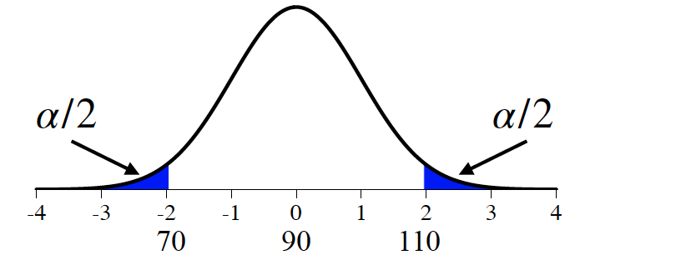
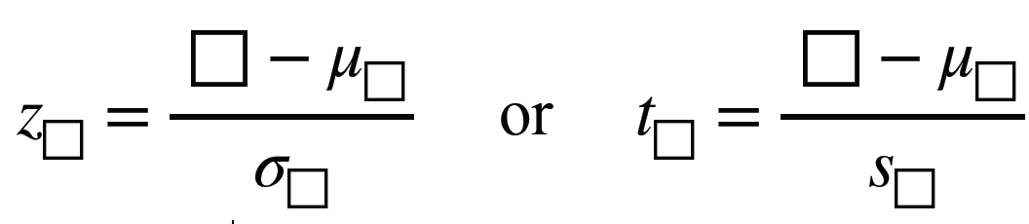
Step 4: Compute Statistics
The Test Statistic
Standardized test ratio
General form:
Where the box is the statistic of interest (e.g., x, x̅)

Slide 41
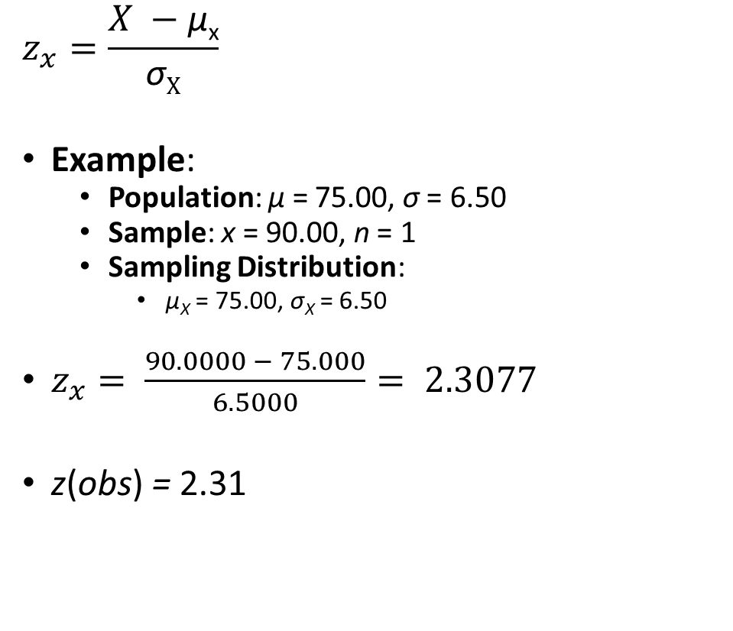
Step 4: Compute Statistics
$$z_{x}=\frac{X −\text{μ}\text{x}}{\text{σ}X}$$
Example:
Population: $\text{μ}$ = 75.00, $\text{σ}$ = 6.50
Sample: x = 90.00, n = 1
Sampling Distribution:
$\text{μ}\text{X}$ = 75.00, $\text{σ}\text{X}$ = 6.50
$z_{x}= \frac{90.0000 − 75.000}{6.5000}= 2.3077$
z(obs) = 2.31

Slide 42
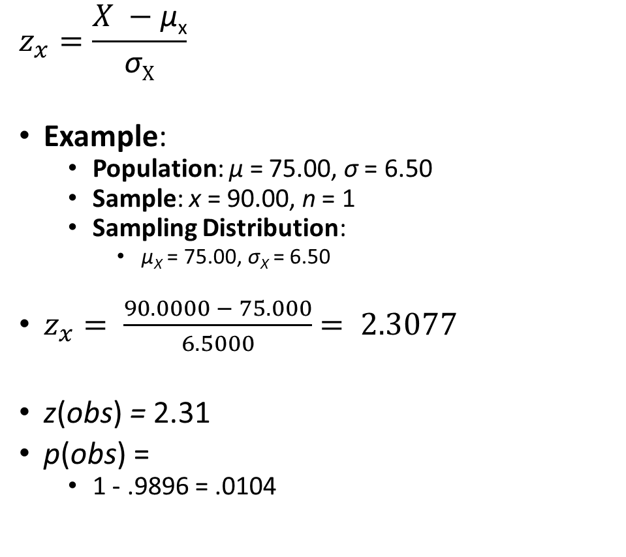
Step 4: Compute Statistics
$$z_{x}=\frac{X −\text{μ}\text{x}}{\text{σ}X}$$
Example:
Population: $\text{μ}$ = 75.00, $\text{σ}$ = 6.50
Sample: x = 90.00, n = 1
Sampling Distribution:
$\text{μ}\text{X}$ = 75.00, $\text{σ}\text{X}$ = 6.50
$z_{x}= \frac{90.0000 − 75.000}{6.5000}$ $= 2.3077$
z(obs) = 2.31
p(obs) =
1 - .9896 = .0104

Slide 43
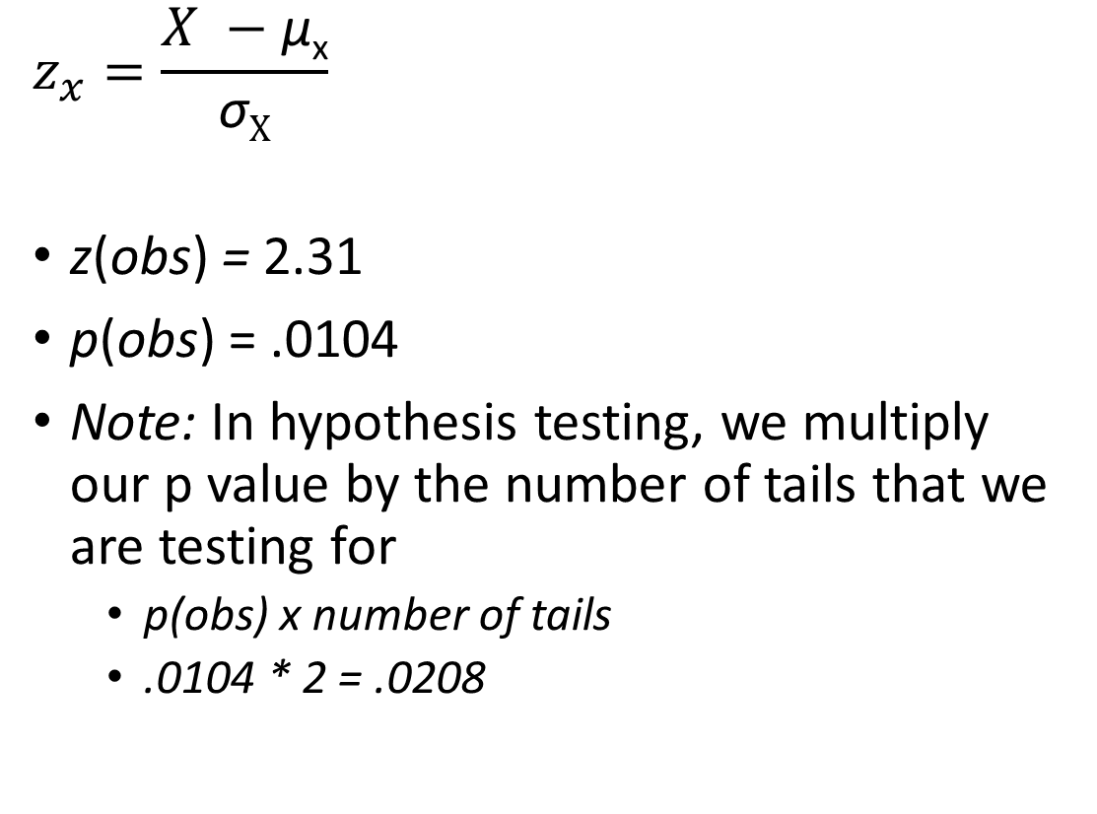
Step 4: Compute Statistics
$$z_{x}=\frac{X −\text{μ}\text{x}}{\text{σ}X}$$
z(obs) = 2.31
p(obs) = .0104
Note: In hypothesis testing, we multiply our p value by the number of tails that we are testing for
p(obs) x number of tails
.0104 * 2 = .0208

Slide 44

Step 1:
H₀: μ = 75.00
H₁: μ ≠ 75.00
Thus, two-tailed
Step 2:
Type of Research Design: Single-Participant Design
Model of Hypothesis Testing: Random Sampling
Nature of Data (Scales of measurement): Score data
Statistic Being Analyzed: X
Information about the Population: μ = 75.00, σ = 6.50, N = 500
Sample Size: n = 1
Shape: Normally distributed
Step 3:
p(α) = .05, z(crit) = ±1.96
Step 4:
z(obs) = $\frac{90.0000 − 75.0000}{6.5000}$ = 2.3077
p(obs) = .0104 x 2 = .0208

Slide 45
Lecture Outline
Steps for Hypothesis Testing
Define Hypotheses
Select Sampling Distribution
Set a priori criteria
Compute statistics
Make statistical decision
Interpret your outcome

Slide 46
Step 5: Make Statistical Decision
We determine whether things (e.g., two groups) are statistically different by
Comparing our p(obs) to our p(α)
Comparing our z(obs) to our z(crit)
Note that comparing p-values or z-values will always lead to the same statistical decision
So, you only actually need to do one comparison

Slide 47
Step 5: Make Statistical Decision
Compare our p(obs) to our p(α)
Compare our z(obs) to our z(crit)
p(obs) = Value determined a posteriori
Reflects the proportion of the sampling distribution that reflects our observed data
Probability your outcome occurred by chance
p(α) = Value decided a priori
Reflects the proportion of the sampling distribution that we’ve designated as a threshold for statistical significance
Probability of which you are willing to make a mistake

Slide 48
Step 5: Make Statistical Decision
Compare our p(obs) to our p(α)
Compare our z(obs) to our z(crit)
p(obs) =
One-Tailed: .0104 x 1 = .0104
Two-Tailed: .0104 x 2 = .0208
p(α) = .05
z(obs) = 2.3077
Note, the z(obs) has to be more extreme than the z(crit)
z(crit) =
One-Tailed: -1.645 or +1.645
Two-Tailed: ±1.96

Slide 49
Step 5: Make Statistical Decision
p(obs) > p(α) AND |z(obs)| < |z(crit)|
Not Significant
Fail to reject the null hypothesis
Suspend Judgment on alternative hypothesis
Outcome is inconclusive
p(obs) < p(α) AND |z(obs)| > |z(crit)|
Significant
Reject the null hypothesis
Accept alternative hypothesis
Data represents a systematic change in behaviour

Slide 50
Step 5: Make Statistical Decision
One Tailed
p(obs) = .0104 < p(α) = .05
Reject the null hypothesis
z(obs) = 2.3077 > z(crit) = 1.645
Reject the null hypothesis
In other words, there IS a difference between Jo’s exam score and past courses

Slide 51
Step 5: Make Statistical Decision
Two Tailed
p(obs) = .0208 < p(α) = .05
Reject the null hypothesis
z(obs) = 2.3077 > z(crit) = ±1.96
Reject the null hypothesis
In other words, there IS a difference between Jo’s exam score and past courses

Slide 52
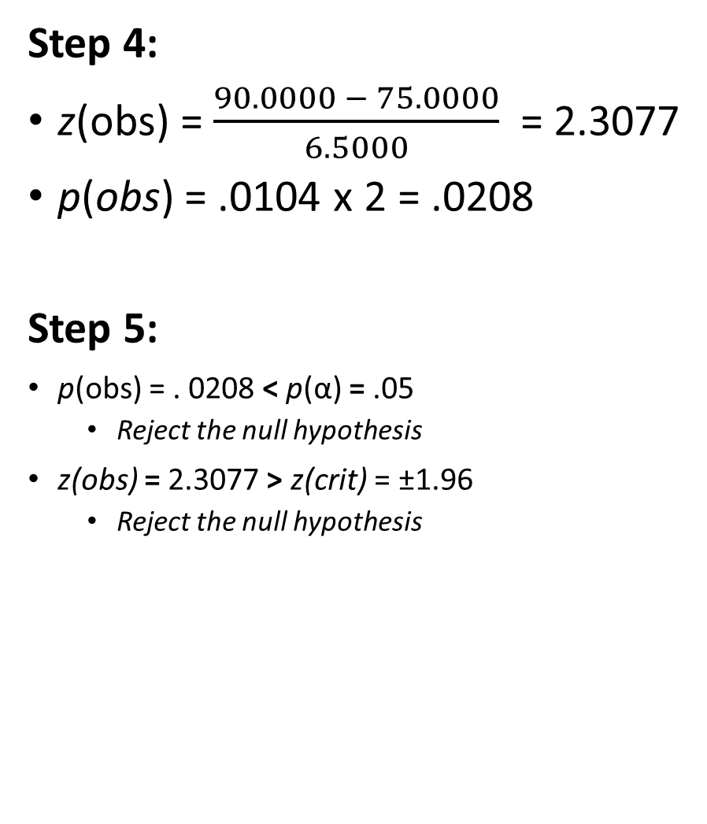
Step 1:
H₀: μ = 75.00
H₁: μ ≠ 75.00
Thus, two-tailed
Step 2:
Type of Research Design: Single-Participant Design
Model of Hypothesis Testing: Random Sampling
Nature of Data (Scales of measurement): Score data
Statistic Being Analyzed: X
Information about the Population: μ = 75.00, σ = 6.50, N = 500
Sample Size: n = 1
Shape: Normally distributed
Step 3:
p(α) = .05, z(crit) = ±1.96
Step 4:
z(obs) = $\frac{90.0000 − 75.0000}{6.5000}$ = 2.3077
p(obs) = .0104 x 2 = .0208
Step 5:
p(obs) = . 0208 < p(α) = .05
Reject the null hypothesis
z(obs) = 2.3077 > z(crit) = ±1.96
Reject the null hypothesis

Slide 53
Lecture Outline
Steps for Hypothesis Testing
Define Hypotheses
Select Sampling Distribution
Set a priori criteria
Compute statistics
Make statistical decision
Interpret your outcome

Slide 54
Step 6: Interpret Your Outcome
Interpret and Report your statistical outcome
Report in APA format
Report in common writing (not jargon other than the statistics themselves)

Slide 55
Step 6: Interpret Your Outcome
Jo’s final exam score of x = 90.00% was statistically greater than the average of past classes (μ = 75.00, σ = 6.50), z = 2.31, p = .021. The statistics problem generator did improve Jo’s exam score.
Only use directional descriptions (e.g., faster, less than) if results are statistically significant
If they are not significant, then there is no difference
E.g., Jo’s final exam score of 90% was not significantly different than…
Decimals: APA format is to report 2 decimals but to report p-values to 3 decimals

Slide 56
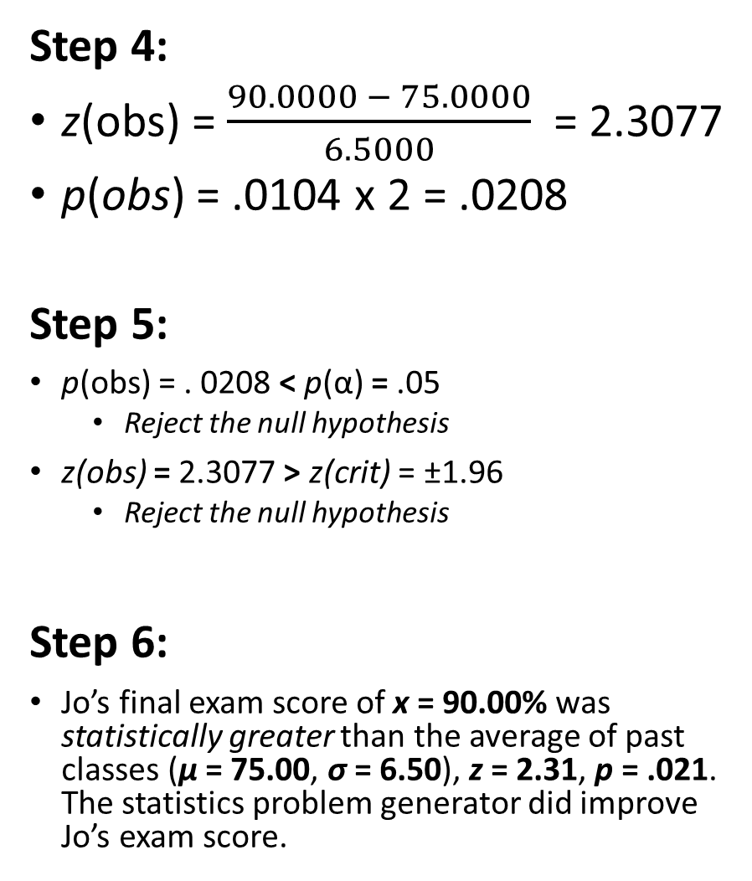
Step 1:
H₀: μ = 75.00
H₁: μ ≠ 75.00
Thus, two-tailed
Step 2:
Type of Research Design: Single-Participant Design
Model of Hypothesis Testing: Random Sampling
Nature of Data (Scales of measurement): Score data
Statistic Being Analyzed: X
Information about the Population: μ = 75.00, σ = 6.50, N = 500
Sample Size: n = 1
Shape: Normally distributed
Step 3:
p(α) = .05, z(crit) = ±1.96
Step 4:
z(obs) = $\frac{90.0000 − 75.0000}{6.5000}$ = 2.3077
p(obs) = .0104 x 2 = .0208
Step 5:
p(obs) = . 0208 < p(α) = .05
Reject the null hypothesis
z(obs) = 2.3077 > z(crit) = ±1.96
Reject the null hypothesis
Step 6:
Jo’s final exam score of x = 90.00% was statistically greater than the average of past classes (μ = 75.00, σ = 6.50), z = 2.31, p = .021. The statistics problem generator did improve Jo’s exam score.

Slide 57
Extra Resources

Slide 58
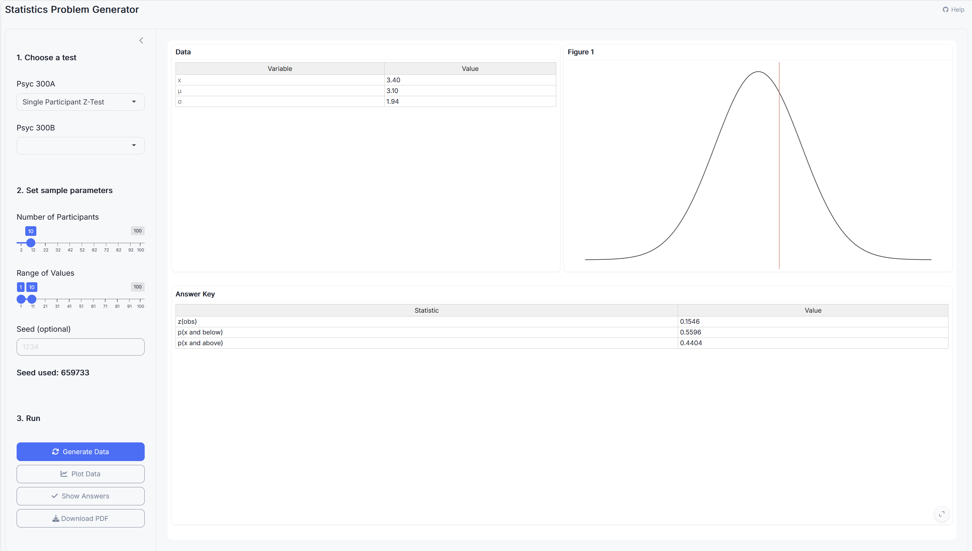
Stats Problem Generator
https://chadcwilliams.shinyapps.io/StatsProblemGenerator/

Slide 59
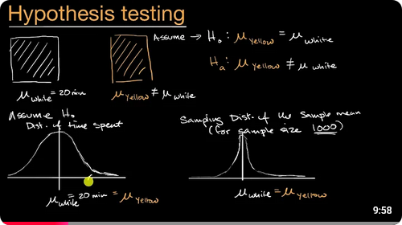
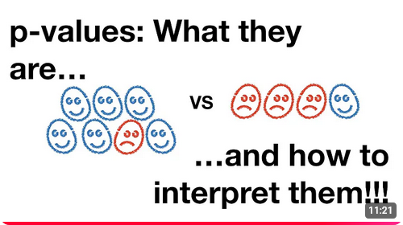
Extra Resources

